Slide 1
Internet of Things
with Raspberry Pi
An introduction to IoT and the scope of this course

Slide 2
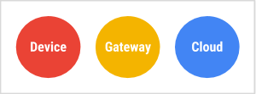
What is IoT
Googles ”definition”
“Internet of Things (IoT) is a sprawling set of technologies and use cases that has no clear, single definition. One workable view frames IoT as the use of network-connected devices, embedded in the physical environment, to improve some existing process or to enable a new scenario not previously possible.”

Slide 3
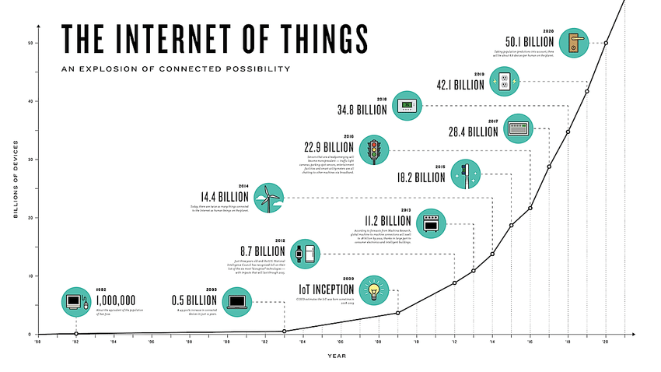
Selim, Mohamed, “An Empirical Analysis on the Microservices Architecture Pattern and Service-Oriented Architecture”, Bachelor Thesis, 2016

Slide 4
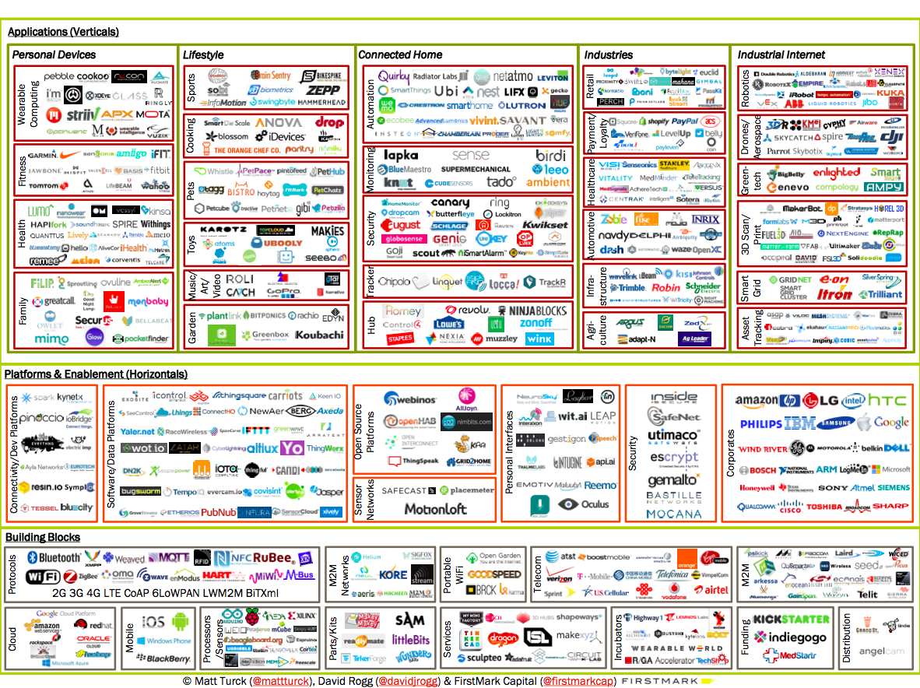

Slide 5
Technologies for this course
Raspberry Pi setup (Raspbian Linux)
Raspberry GPIO, for sensors and actuators
Python3
Basic electronics
MQTT, publish/subscribe async messaging
Data aggregation and management
REST service
Web presentation

Slide 6
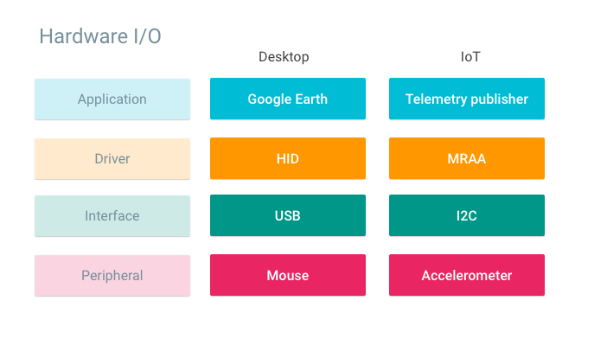

Slide 7
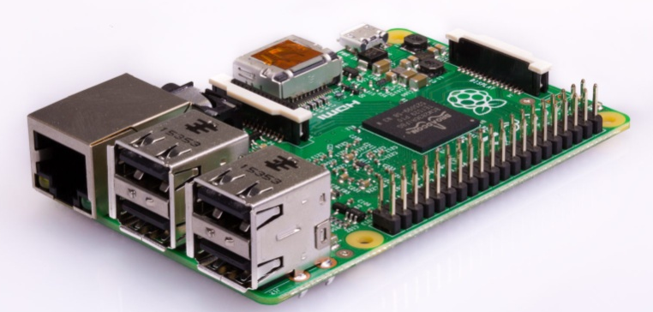
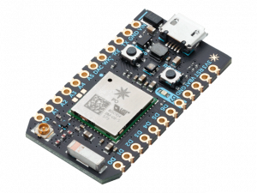
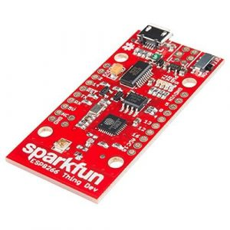
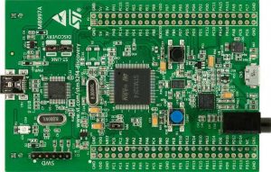
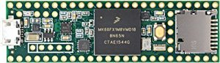
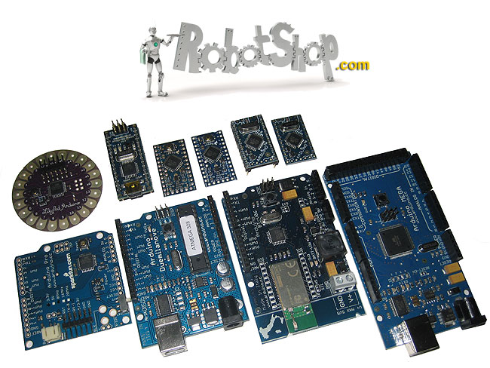
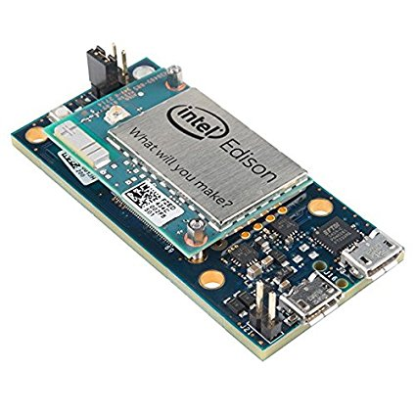
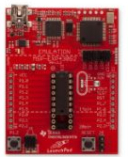
Particle Photon
Raspberry Pi
ESP8266
Teensy
STM32
Arduionos
Intel Edison
MSP430

Slide 8
Model | Processor clock | System /Flash | Network | I/0
Arduino UNO | 16 Mhz | 2kB/32kB | None | SPI I2C UART GPIO
ESP8266 | 26-52 Mhz | 45kB/126MB | WiFi | UART GPIO
Raspberry Pi 3 model B+ | 1.2 Ghz quad | 1GB | Ethernet, WiFi, Bluetooth | SPI DSI I2C UART GPIO
Intel Edison | 500 Mhz dual | 1GB/4GB | WiFi, Bluetooth | UART I2C SPI I2S GPIO
Teensy | 72 Mhz | 64kB | None | UART SPI I2C CAN I2S
Particle Photon | 120 Mhz | 128kB/1MB | WiFi | SPI I2C I2S CAN PWM
MSP430 (x6xx series) | 25 Mhz | 66kB/512kB | None | GPIO I2C UART
STM32 (WB series) | 64 Mhz/32 Mhz (radio) | 256kB/1MB | Bluetooth ZigBee | I2C UART SPI

Slide 9
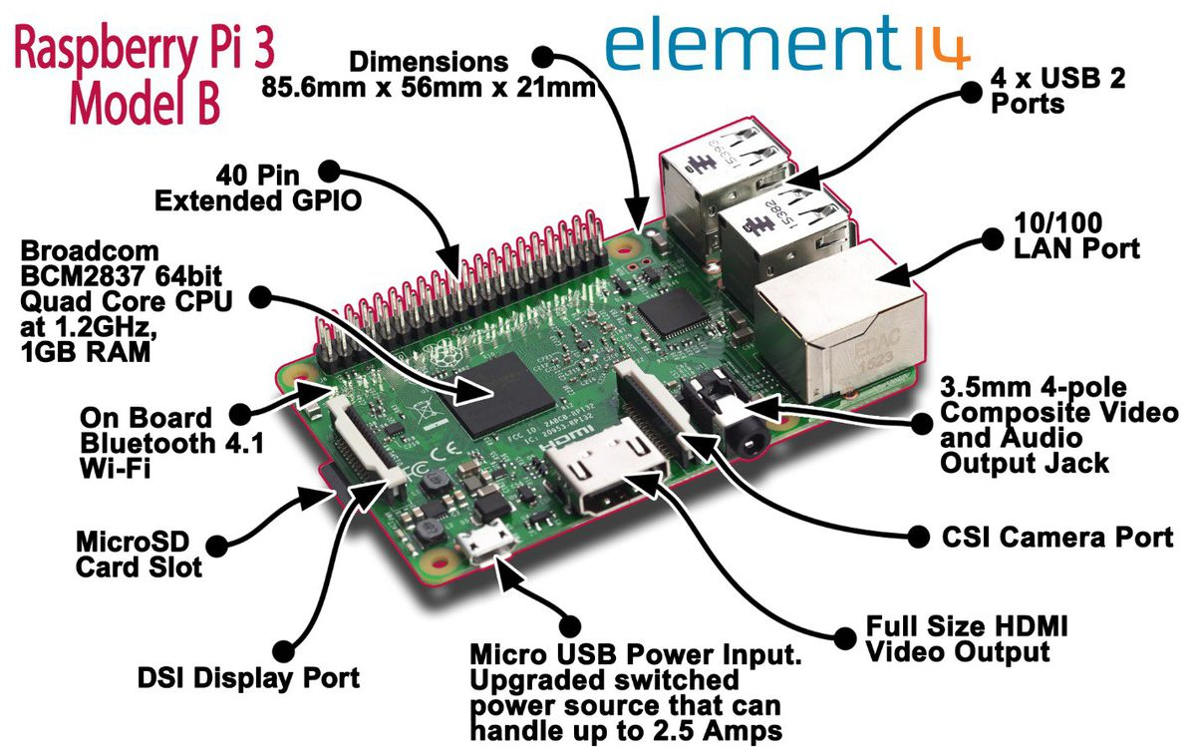

Slide 11
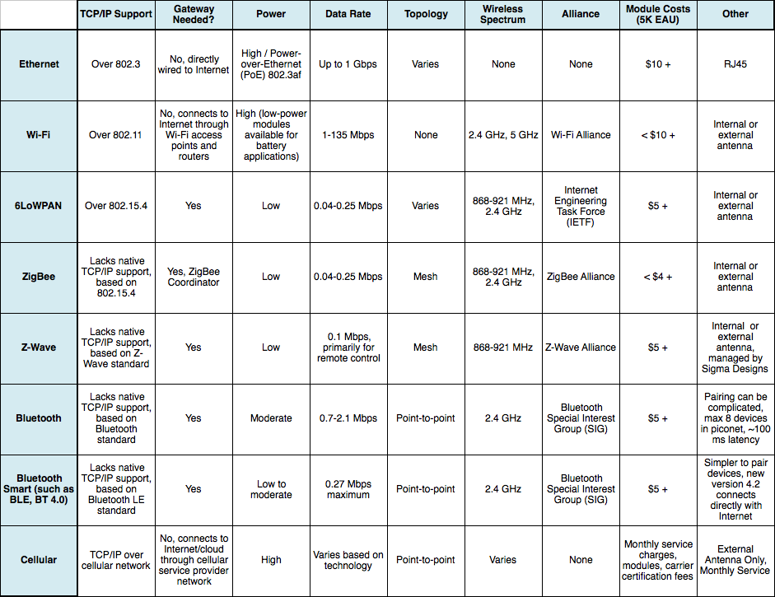

Slide 12
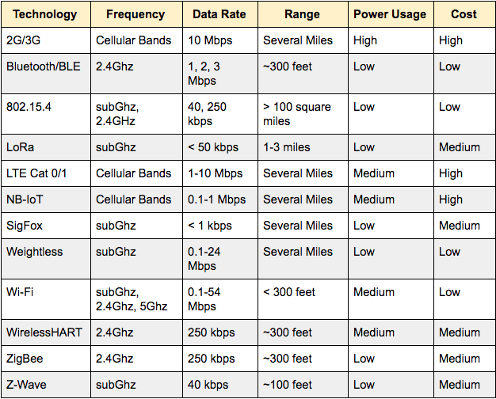

Slide 13
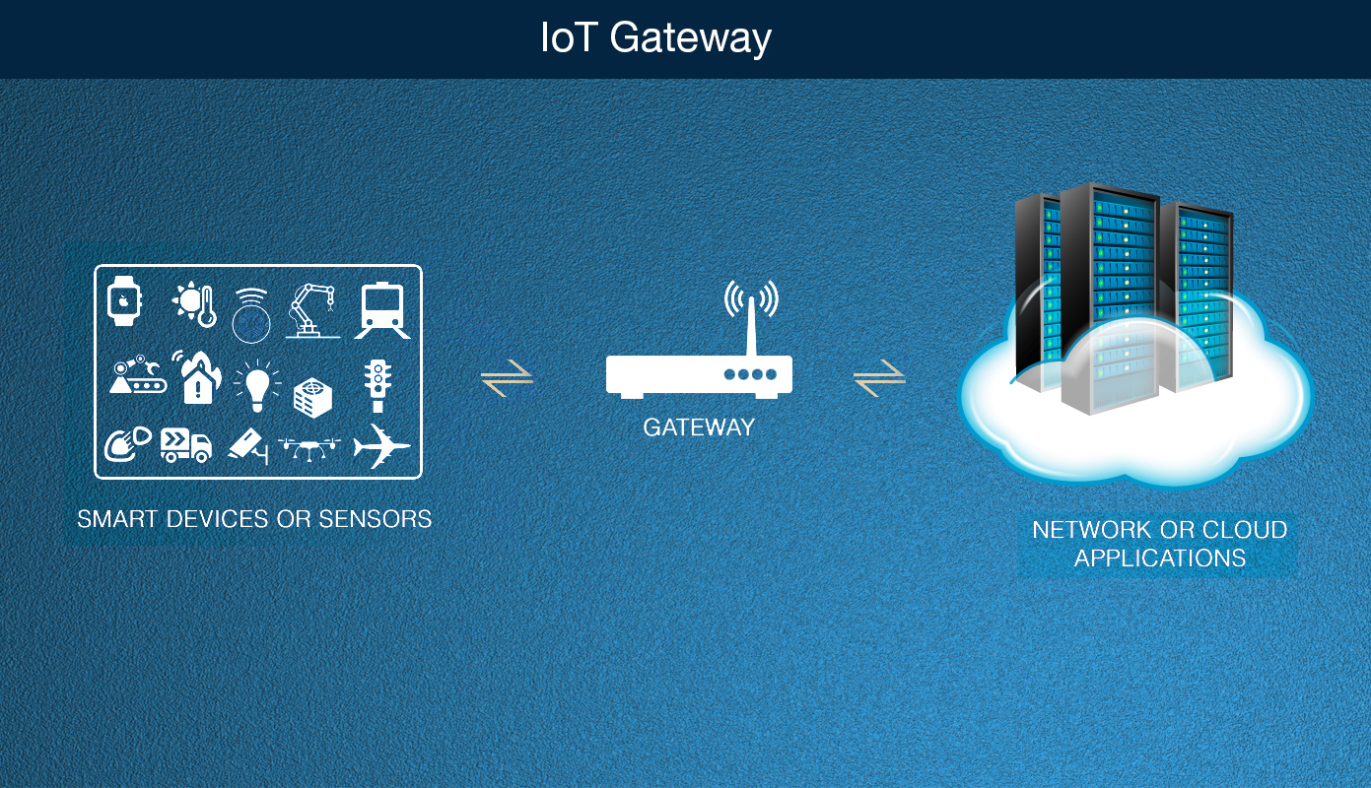

Slide 14
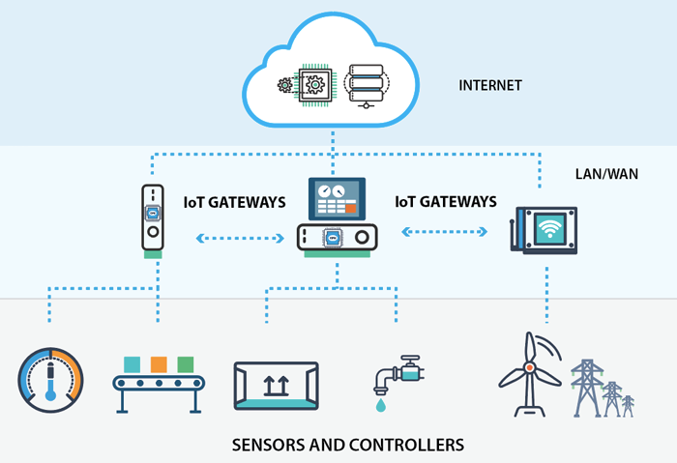

Slide 15
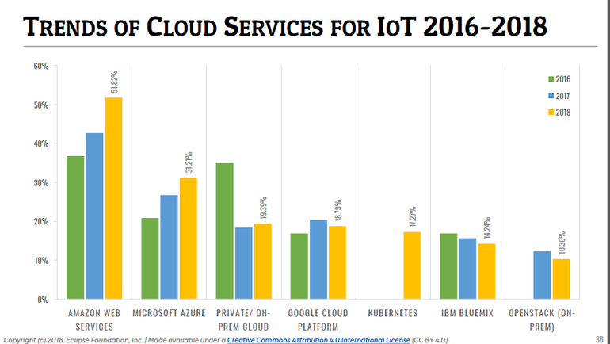

Slide 16
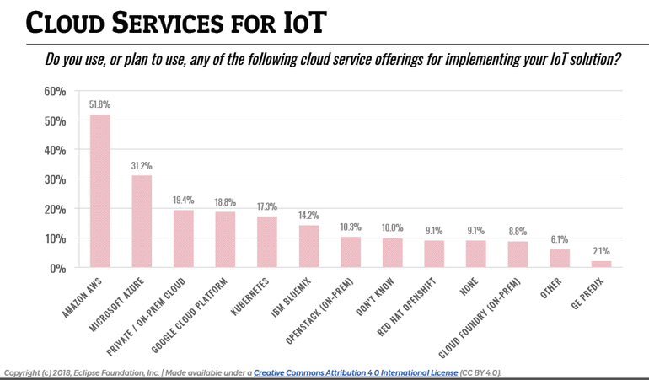

Slide 17
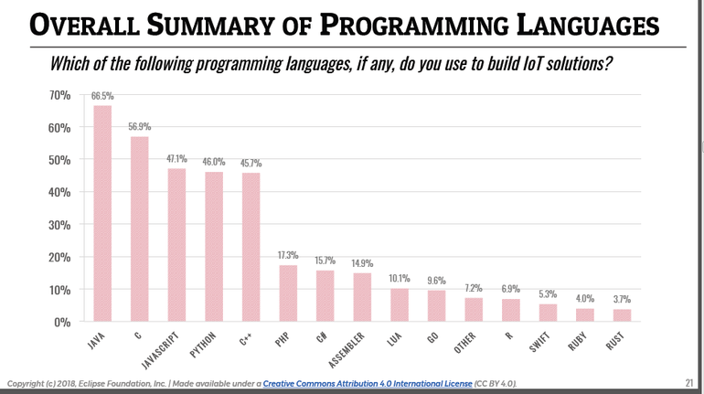

Slide 18
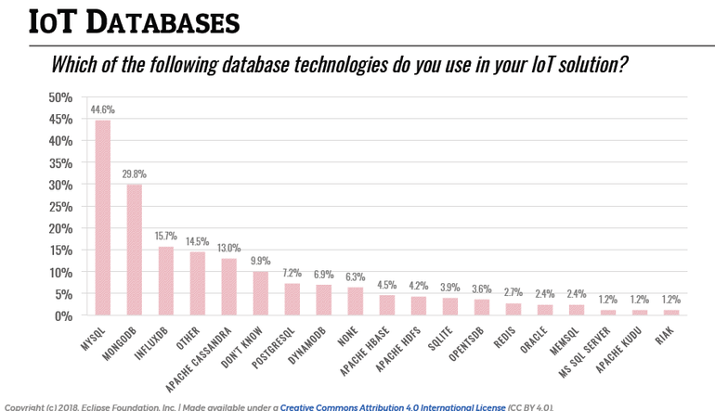

Slide 19
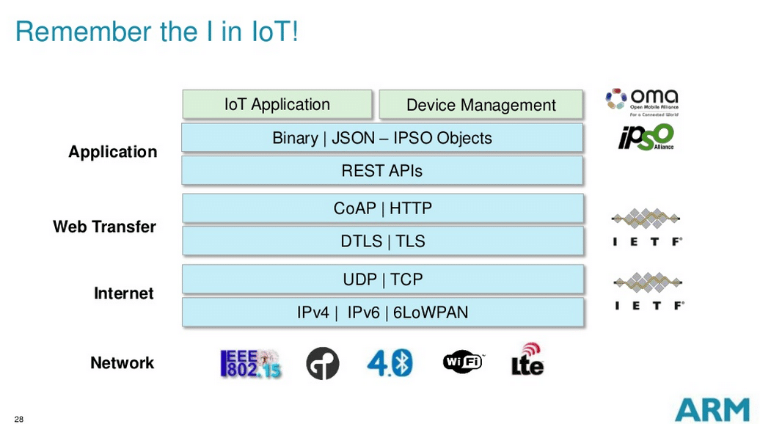
Credit: Simon Ford - Director of IoT Platforms ARM

Slide 20
 | MQTT | CoAP
Established | 1999 (2013 OASIS standard) | 2014
Messaging Pattern | Publish/subscribe via message broker | Request/response (client-server)
Transport | Transmission Control Protocol (TCP) | User Datagram Protocol (UDP)
Security | SSL/TLS over TCP | DTLS over UDP
Strengths | Broker architecture can simplify management; TCP and quality of service options enable robust message delivery | Fast and efficient due to reliance on low-overhead UDP; RESTful model is welcoming to developers and provides for integrated resource discovery
Weaknesses | Always-on TCP connections limit utility for low-power devices; SSL/TLS encryption a poor match for constrained clients | Lacks the reliability and service guarantees of TCP-based MQTT
Notes:
Source: https://www.logicsupply.com/explore/io-hub/connecting-the-iot-mqtt-coap-protocols/

